Slide 1

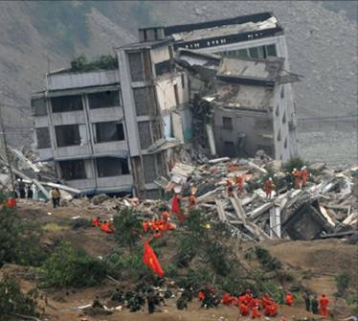
1
Functions and Models
Copyright © Cengage Learning. All rights reserved.

Slide 2
Introduction to calculus
What is calculus and why we study it?
It is extremely difficult to answer this question briefly and convincingly for that world require paraphrasing this entire subject into just a few lines of text. The simplest definition is
“Calculus is the branch of mathematics that involves the rate of change”
1.1
Mathematics: Essentially mathematics is nothing more than the language of science while science is a symmetric study of nature, mathematics is a concise form of communication used to represent nature.

Slide 3
Introduction to calculus
What is meant by change?
Changes are the results of action that comprise a situation. Due to passage of event, some thing must change w.r.t itself. For example a moving objects implies a changing distance covered from a reference point. Or rising temperature implies that the temperature is changed. Change is relative concept that involve any pair of dimension such as time, force, mass, length etc.
1.1
The purpose of studying calculus is simply to introduced your mind to scientific method of analysis and how to apply your mind in a systematic manner towards understanding the world around you. It is used to determine how particles, stars and matter actually move and change in real time.

Slide 4
Introduction to calculus
Branches of calculus
Differential calculus
Integral calculus
Determines the rate of
change of a quantity i.e curves and slope.
Seeks to find the quantity where the rate of change is known. Further it figure out the total size or values i.e length , area, volume.

Slide 5
Introduction to calculus
Who invented Calculus
Calculus was developed in the latter half of the 7th century by two famous mathemations Gottfried Leibnize and Isaac Newton.

Slide 6
Four Ways to Represent a Function
Functions arise whenever one quantity depends on
another. Consider the following four situations.
A. The area A of a circle depends on the radius r of the
circle. The rule that connects r and A is given by the
equation A = π r ². With each positive number r there is
associated one value of A, and we say that A is a
function of r.

Slide 7
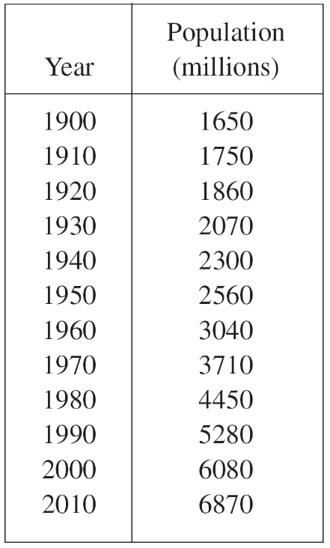
Four Ways to Represent a Function
B. The human population of the world P depends on the time t. The table gives estimates of the world population P (t) at time t, for certain years. For instance,
P(1950) ≈ 2,560,000,000
But for each value of the time t
there is a corresponding value
of P, and we say that P is a function of t.

Slide 8
Four Ways to Represent a Function
C. The cost C of mailing a large envelope depends on the weight w of the envelope. Although there is no simple formula that connects w and C, the post office has a rule for determining C when w is known.
D. The vertical acceleration a of the ground as measured
by a seismograph during an earthquake is a function of
the elapsed time t.

Slide 9
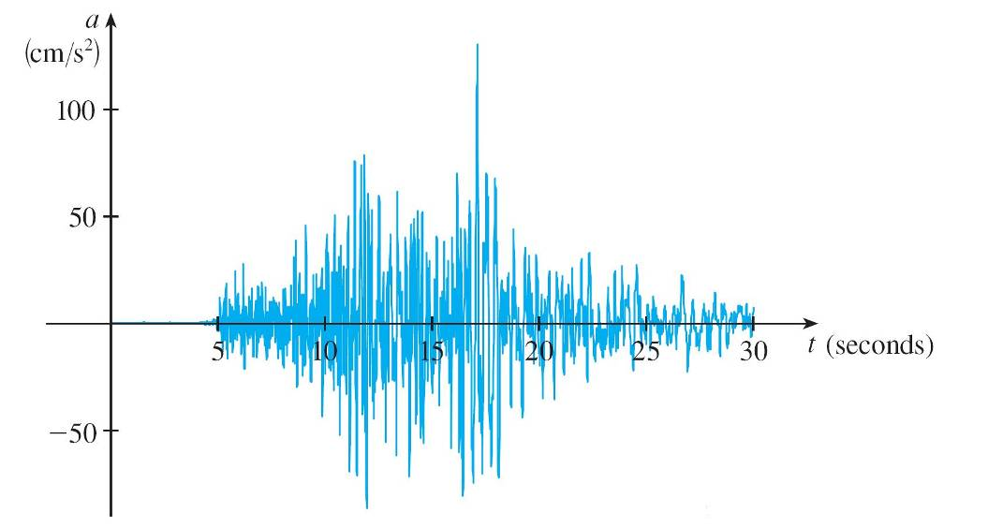
Four Ways to Represent a Function
Figure 1 shows a graph generated by seismic activity
during the Northridge earthquake that shook Los
Angeles in 1994. For a given value of t, the graph
provides a corresponding value of a.
Vertical ground acceleration during the Northridge earthquake
Figure 1

Slide 10
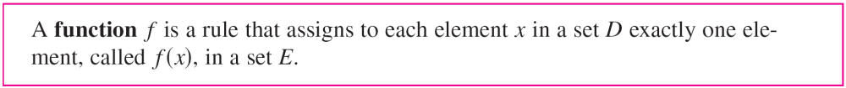
Four Ways to Represent a Function
We usually consider functions for which the sets D and E are sets of real numbers. The set D is called the domain of the function.
The number f (x) is the value of f at x and is read “f of x.” The range of f is the set of all possible values of f (x) as x varies throughout the domain.
A symbol that represents an arbitrary number in the domain of a function f is called an independent variable.

Slide 11
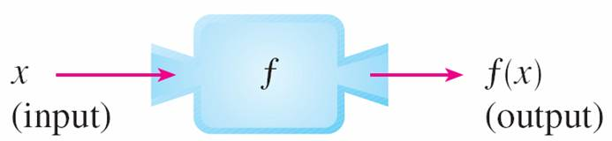
Four Ways to Represent a Function
A symbol that represents a number in the range of f is called a dependent variable. In Example A, for instance, r is the independent variable and A is the dependent variable.
It’s helpful to think of a function as a machine
(see Figure 2).
Machine diagram for a function f
Figure 2

Slide 12
Four Ways to Represent a Function
If x is in the domain of the function f, then when x enters the machine, it’s accepted as an input and the machine produces an output f (x) according to the rule of the function.
Thus we can think of the domain as the set of all possible inputs and the range as the set of all possible outputs.

Slide 13
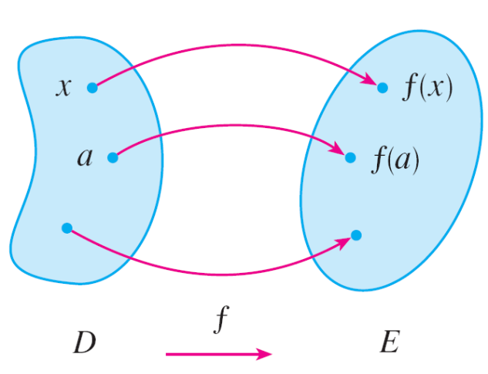
Four Ways to Represent a Function
Another way to picture a function is by an arrow diagram as in Figure 3.
Each arrow connects an element of D to an element of E. The arrow indicates that f (x) is associated with x, f (a) is associated with a, and so on.
Arrow diagram for f
Figure 3

Slide 14
Four Ways to Represent a Function
The most common method for visualizing a function is its graph. If f is a function with domain D, then its graph is the set of ordered pairs
{(x, f (x)) | x ∈ D}
In other words, the graph of f consists of all points (x, y)
in the coordinate plane such that y = f (x) and x is in the domain of f.
The graph of a function f gives us a useful picture of the behavior or “life history” of a function.

Slide 15
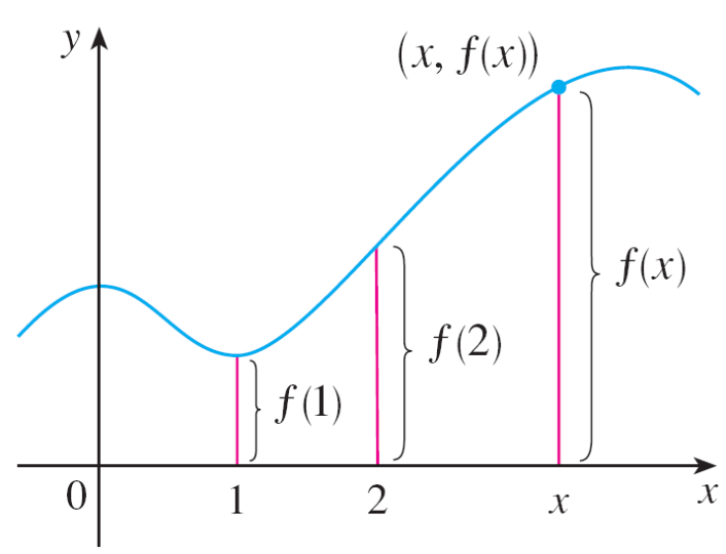
Four Ways to Represent a Function
Since the y-coordinate of any point (x, y) on the graph is
y = f (x), we can read the value of f (x) from the graph as being the height of the graph above the point x
(see Figure 4).
Figure 4

Slide 16
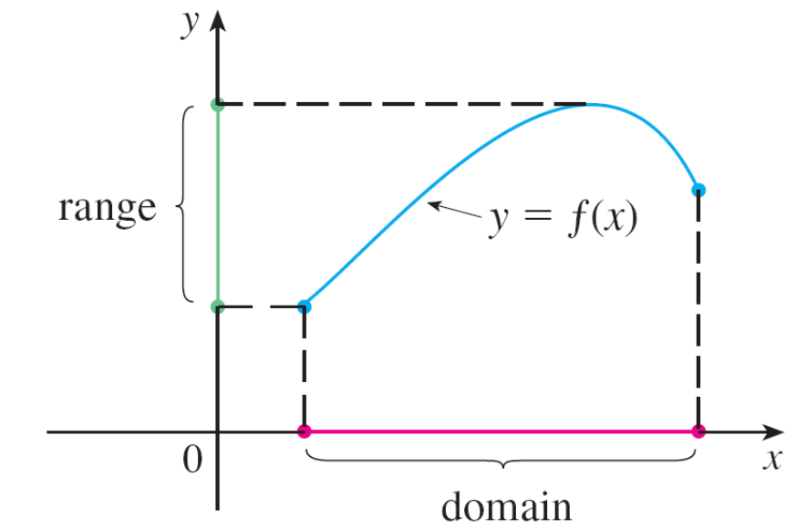
Four Ways to Represent a Function
The graph of f also allows us to picture the domain of f on the x-axis and its range on the y-axis as in Figure 5.
Figure 5

Slide 17
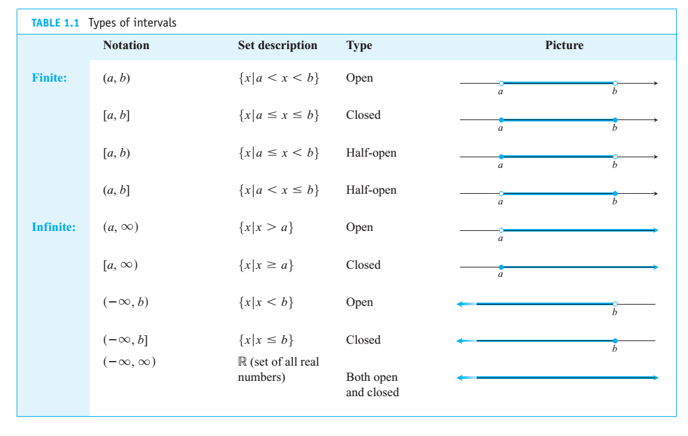
Types of intervals

Slide 18
Representations of Functions
There are four possible ways to represent a function:
verbally (by a description in words)
numerically (by a table of values)
visually (by a graph)
algebraically (by an explicit formula)

Slide 19
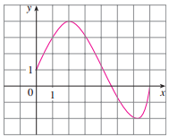
Problem 1
The graph of a function f is shown in Figure 6.
(a) Find the values of f (1) and f (5).
(b) What are the domain and range of f ?
Figure 6
The notation for intervals is given in Appendix A.

Slide 20
Problem 1 – Solution
(a) We see from Figure 6 that the point (1, 3) lies on the graph of f, so the value of f at 1 is f (1) = 3. (In other
words, the point on the graph that lies above x = 1 is 3
units above the x-axis.)
When x = 5, the graph lies about 0.7 unit below the x-axis, so we estimate that f(5) ≈ –0.7.
(b) We see that f (x) is defined when 0 ≤ x ≤ 7, so the
domain of f is the closed interval [0, 7]. Notice that f
takes on all values from –2 to 4, so the range of f is
{y | –2 ≤ y ≤ 4} = [–2, 4]

Slide 21
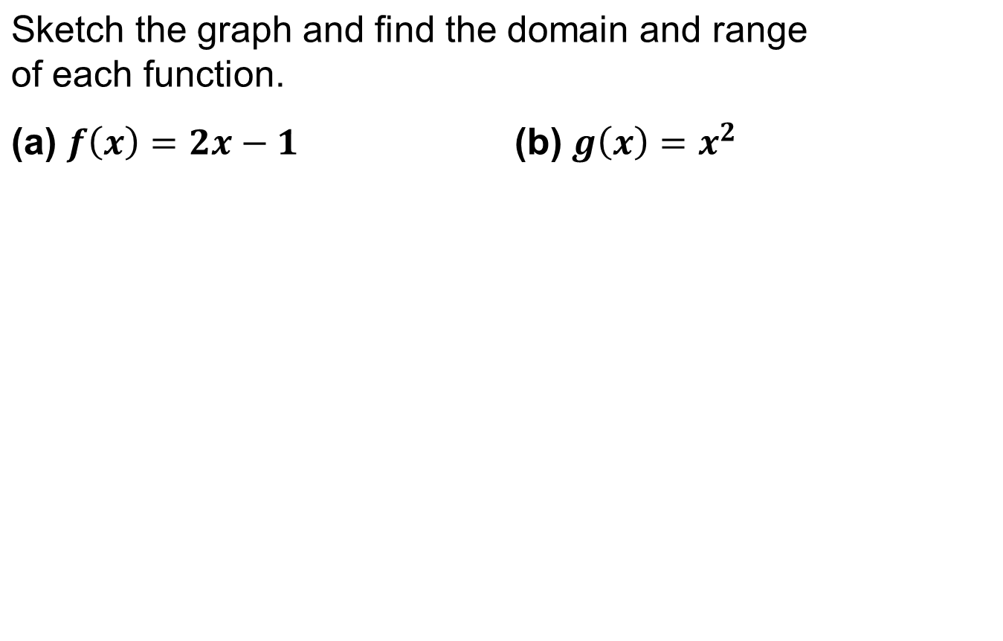
Problem 2

Slide 22
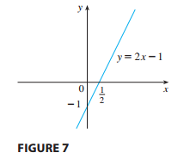
Problem 2 – Solution
The domain of ƒ is set of R
The graph shows that the range
is also R.

Slide 23
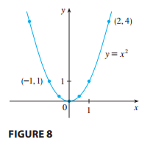


Problem 2 – Solution
(b) The domain of g is R.
Range: {y | y 0 } = [0, )

Slide 24
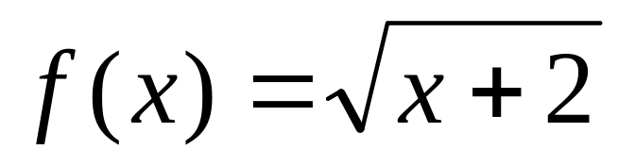
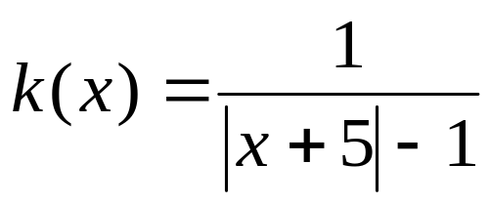
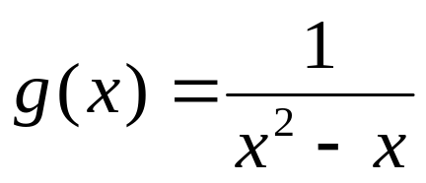
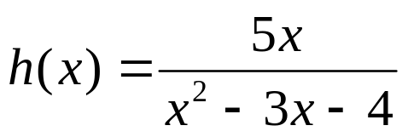
Problem 6
Find the domain of each function.
(a)
(b)
(c)
(d)

Slide 25
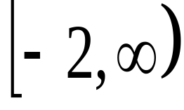

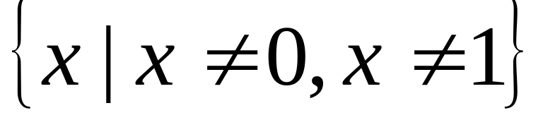
Problem 6 – Solution
Find the domain of each function.
(a)
The domain is the interval
(b)
The domain is

Slide 26
Representations of Functions

Slide 27
Representations of Functions

Slide 28
Problem 4
When you turn on a hot-water faucet, the temperature T of the water depends on how long the water has been running. Draw a rough graph of T as a function of the time t that has elapsed since the faucet was turned on.
Solution:
The initial temperature of the running water is close to room temperature because the water has been sitting in the pipes.
When the water from the hot-water tank starts flowing from the faucet, T increases quickly. In the next phase, T is constant at the temperature of the heated water in the tank.

Slide 29
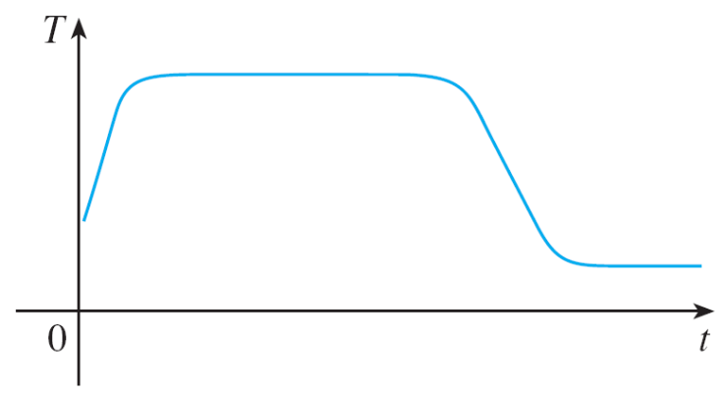
Problem 4 – Solution
cont’d
When the tank is drained, T decreases to the temperature of the water supply.
This enables us to make the rough sketch of T as a function of t in Figure 11.
Figure 11

Slide 30
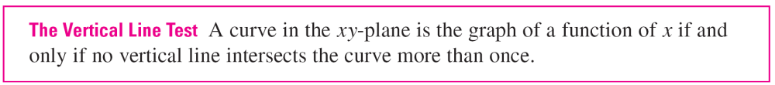
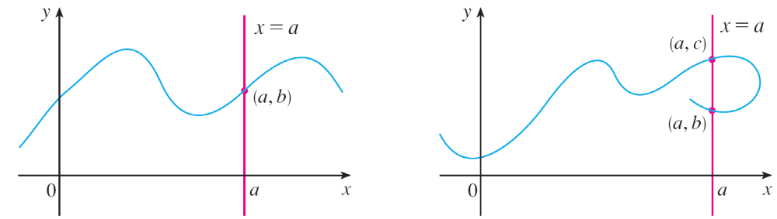
Representations of Functions
The graph of a function is a curve in the xy-plane. But the question arises: Which curves in the xy-plane are graphs of functions? This is answered by the following test.
The reason for the truth of the Vertical Line Test can be seen in Figure 13.
Figure 13

Slide 31
Representations of Functions
If each vertical line x = a intersects a curve only once, at (a, b), then exactly one functional value is defined by f (a) = b.
But if a line x = a intersects the curve twice, at (a, b) and
(a, c), then the curve can’t represent a function because a function can’t assign two different values to a.

Slide 32
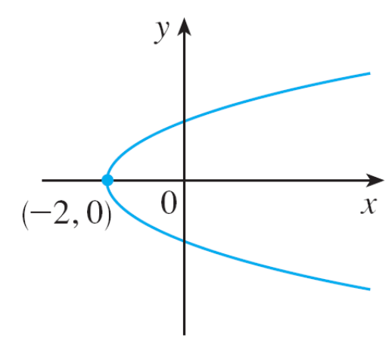
Representations of Functions
For example, the parabola x = y² – 2 shown in Figure 14(a) is not the graph of a function of x because, as you can see, there are vertical lines that intersect the parabola twice. The parabola, however, does contain the graphs of two functions of x.
x = y² – 2
Figure 14(a)

Slide 33



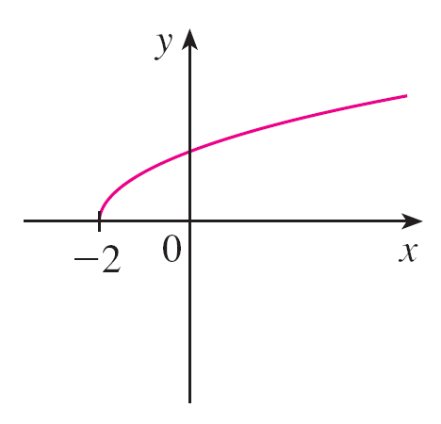
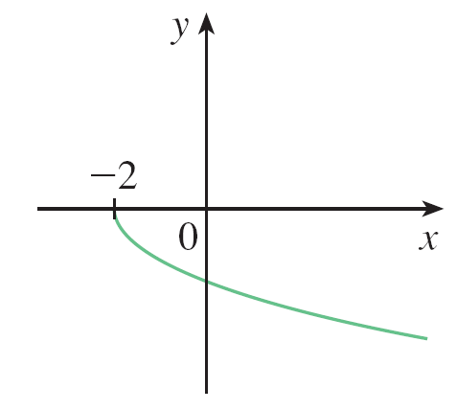


Representations of Functions
Notice that the equation x = y² – 2 implies y² = x + 2, so .
Thus the upper and lower halves of the parabola are the graphs of the functions and [See Figures 14(b) and (c).]
Figure 14(b)
Figure 14(c)

Slide 34
Representations of Functions
We observe that if we reverse the roles of x and y, then the equation x = h (y) = y² – 2 does define x as a function of y (with y as the independent variable and x as the dependent variable) and the parabola now appears as the graph of the function h.

Slide 35
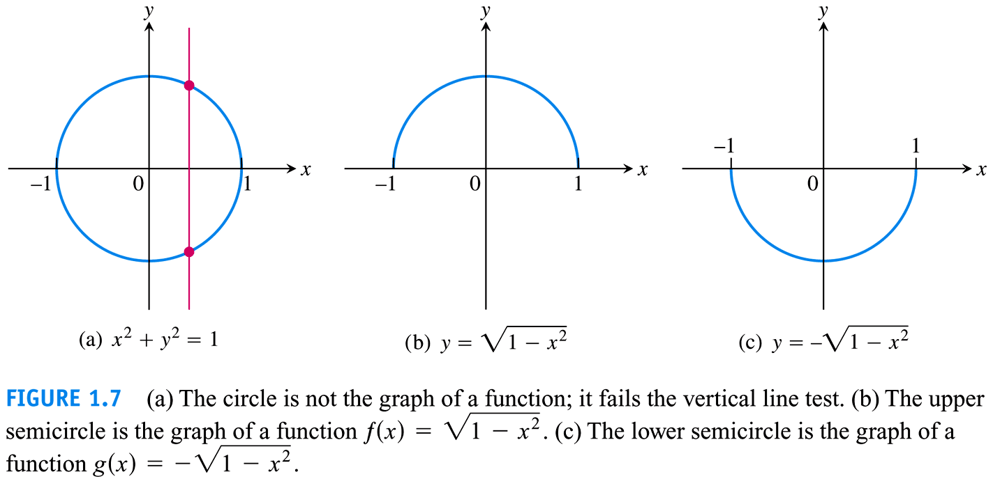
Representations of Functions
Problem: Thomas’s Calculus Twelfth Edition

Slide 36
Piecewise Defined Functions

Slide 37

Problem 7
A function f is defined by
1 – x if x ≤ –1
x² if x > –1
Evaluate f (–2), f (–1), and f (0) and sketch the graph.
Solution:
Remember that a function is a rule. For this particular function the rule is the following:
First look at the value of the input x. If it happens that x ≤ –1, then the value of f (x) is 1 – x.
f (x) =

Slide 38
Problem 7 – Solution
cont’d
On the other hand, if x > –1, then the value of f (x) is x².
Since (–2 ≤ –1, we have f (–2) = 1 – (–2) = 3.
Since –1 ≤ –1, we have f (–1) = 1 – (–1) = 2.
Since 0 > –1, we have f (0) = 0² = 0.

Slide 39
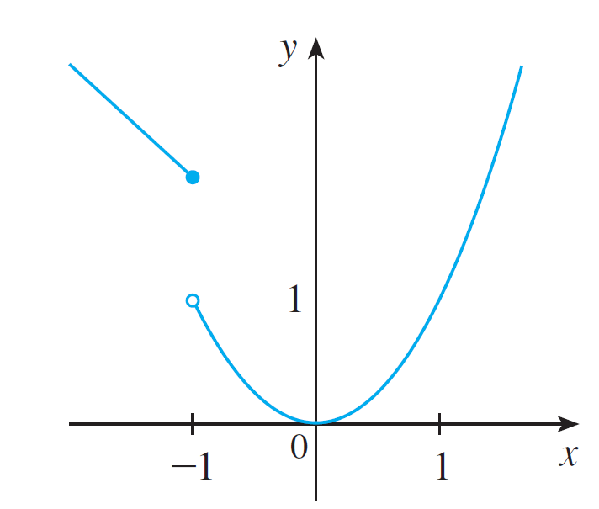
Problem 7 – Solution
cont’d
The solid dot indicates that the point (–1, 2) is included on the graph; the open dot indicates that the point (–1, 1) is excluded from the graph.
Figure 15

Slide 40
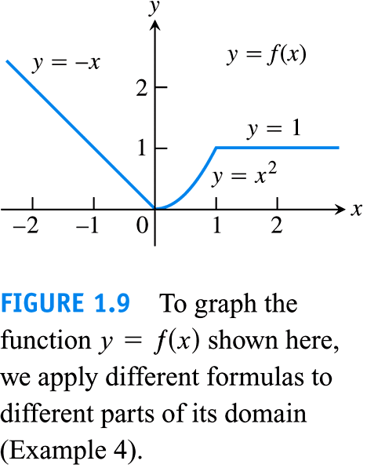
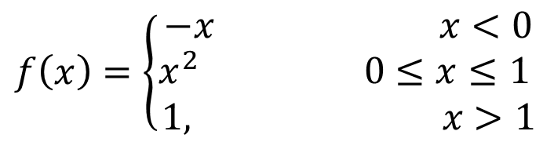
Thomas’s Calculus Twelfth Edition

Slide 41

Piecewise Defined Functions
The next example of a piecewise defined function is the absolute value function. Recall that the absolute value of a number a, denoted by | a |, is the distance from a to 0 on the real number line. Distances are always positive or 0, so we have
| a | ≥ 0 for every number a
For example,
| 3 | = 3 | – 3 | = 3 | 0 | = 0 | – 1 | = – 1
| 3 – π | = π – 3

Slide 42
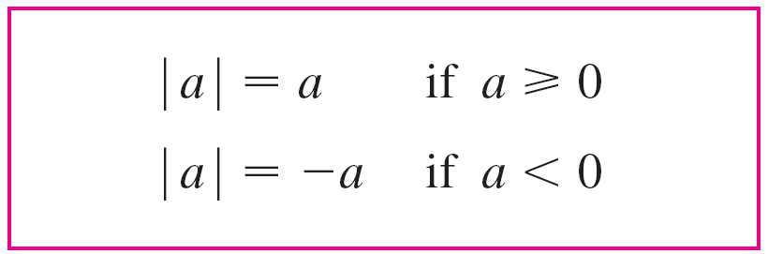
Piecewise Defined Functions
In general, we have
(Remember that if a is negative, then –a is positive.)

Slide 43

Problem 8
Sketch the graph of the absolute value function f (x) = |x|.
Solution:
From the preceding discussion we know that
x if x ≥ 0
|x| =
– x if x < 0

Slide 44
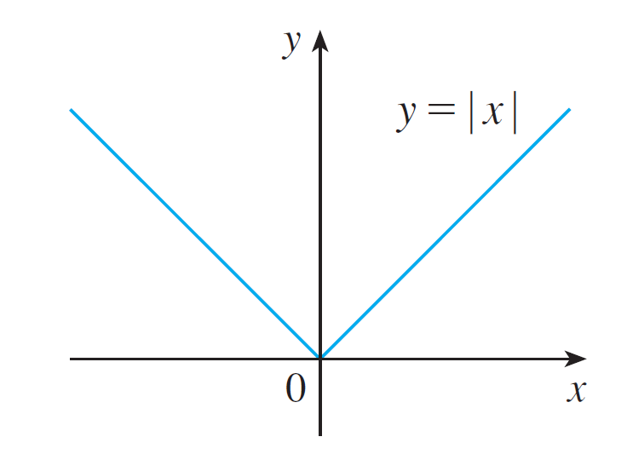
Problem 8 – Solution
cont’d

Slide 45

Problem 10
In Example C at the beginning of this section we considered the cost C (w) of mailing a large envelope with weight w.
In effect, this is a piecewise defined function because, from the table of values on page 13, we have
0.88 if 0 < w ≤ 1
1.05 if 1 < w ≤ 2
C (w) = 1.22 if 2 < w ≤ 3
1.39 if 3 < w ≤ 4

Slide 46
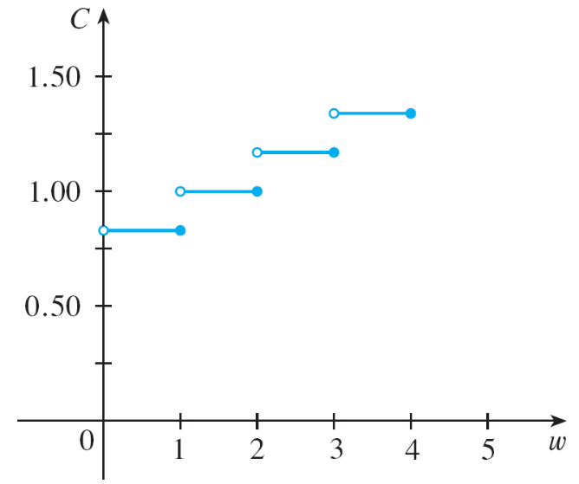
Problem 10
cont’d
The graph is shown in Figure 18.
You can see why functions similar to this one are called step functions—they jump from one value to the next.
Figure 18

Slide 47
Symmetry

Slide 48
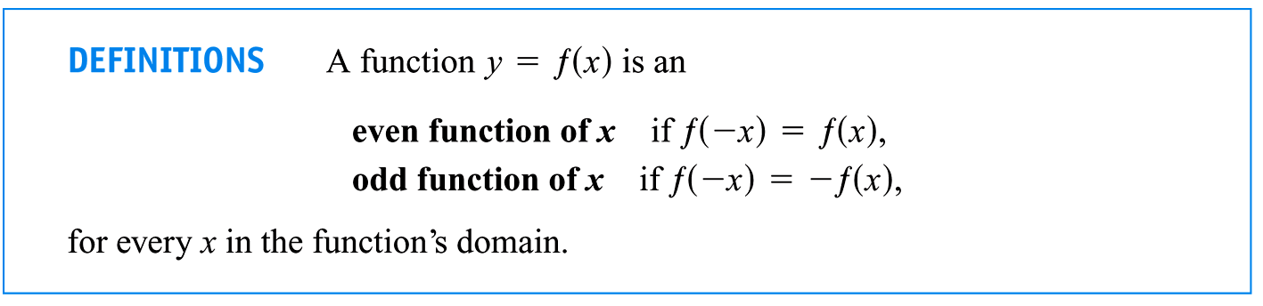
Symmetry

Slide 49
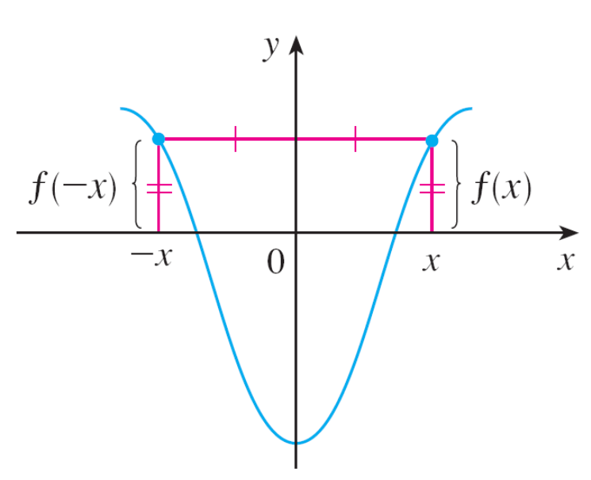
Symmetry
Even function. For instance, the function f (x) = x² is even because
f (–x) = (–x)² = x² = f (x)
The geometric significance of an
even function is that its graph is
symmetric with respect to the y-axis
(see Figure 19).
An even function
Figure 19

Slide 50
Symmetry
This means that if we have plotted the graph of f for x ≥ 0,
we obtain the entire graph simply by reflecting this portion about the y-axis.
Odd function. For example, the function f (x) = x³ is odd because
f (–x) = (–x)³ = –x³ = –f (x)

Slide 51
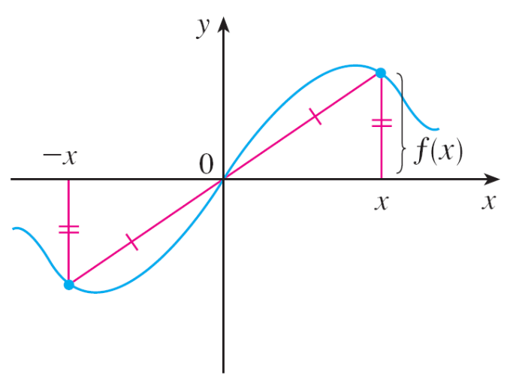
Symmetry
The graph of an odd function is symmetric about the origin (see Figure 20).
If we already have the graph of f for x ≥ 0, we can obtain the entire graph by rotating this portion through 180° about the origin.
An odd function
Figure 20

Slide 52
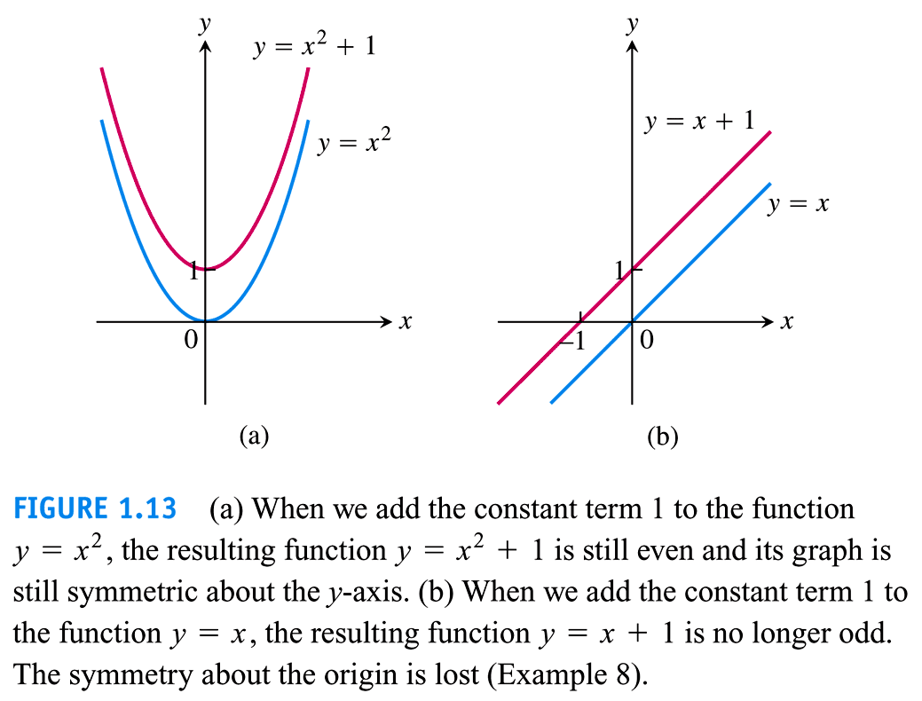
Symmetry Important Point

Slide 53
Problem 11
Determine whether each of the following functions is even, odd, or neither even nor odd.
(a) f (x) = x⁵ + x (b) g (x) = 1 – x⁴ (c) h (x) = 2x – x²
Solution:
(a) f (–x) = (–x)⁵ + (–x) = (–1)⁵x⁵ + (–x)
= –x⁵ – x = –(x⁵ + x)
= –f (x)
Therefore f is an odd function.

Slide 54
Problem 11 – Solution
cont’d
(b) g (–x) = 1 – (–x)⁴ = 1 – x⁴ = g (x)
So g is even.
(c) h(–x) = 2(–x) – (–x)² = –2x – x²
Since h(–x) ≠ h (x) and h(–x) ≠ –h (x), we conclude that h
is neither even nor odd.

Slide 55
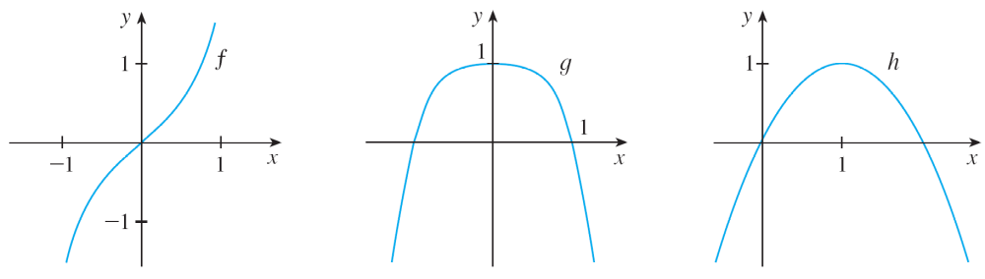
Symmetry
The graphs of the functions in Example 11 are shown in Figure 21. Notice that the graph of h is symmetric neither about the y-axis nor about the origin.
(a)
(b)
(c)
Figure 21

Slide 56
Increasing and Decreasing Functions

Slide 57
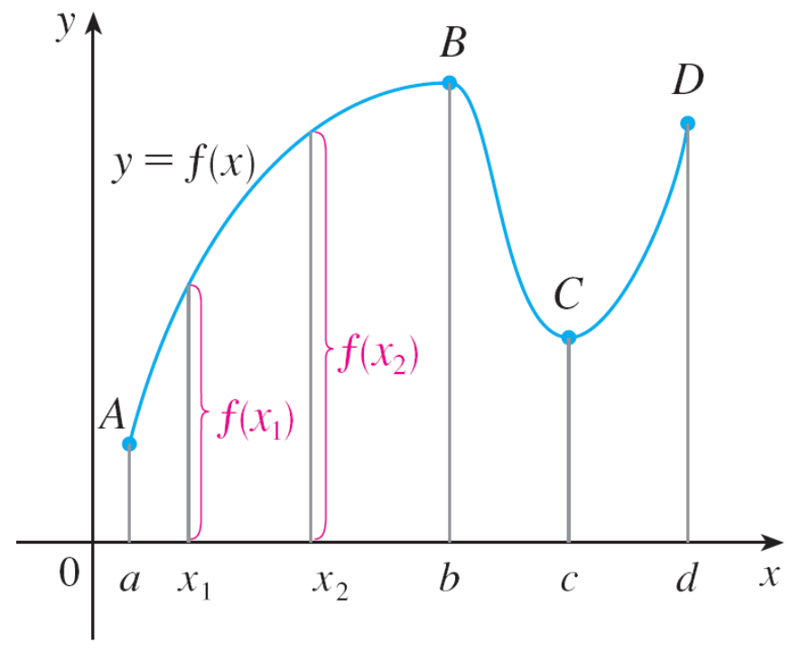
Increasing and Decreasing Functions
The graph shown in Figure 22 rises from A to B, falls from B to C, and rises again from C to D. The function f is said to be increasing on the interval [a, b], decreasing on [b, c], and increasing again on [c, d].
Figure 22

Slide 58
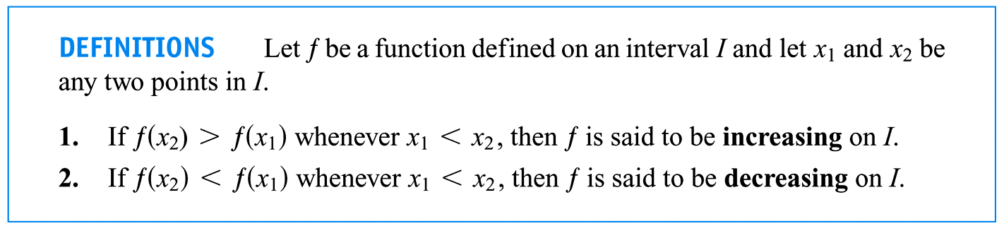
Increasing and Decreasing Functions
Notice that if x₁ and x₂ are any two numbers between a and b with x₁ < x₂, then f (x₁) < f (x₂).
We use this as the defining property of an increasing function.

Slide 59
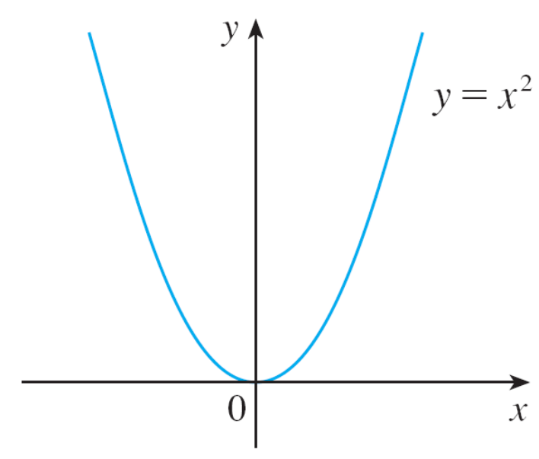

Increasing and Decreasing Functions
In the definition of an increasing function it is important to realize that the inequality f (x₁) < f (x₂) must be satisfied for every pair of numbers x₁ and x₂ in I with x₁ < x₂.
You can see from Figure 23
that the function f (x) = x² is
decreasing on the interval (– , 0]
and increasing on the interval
[0, ).
Figure 23

